Slide 1
SPaG/GaPS
Spelling, Punctuation and Grammar
Notes:
Robyn

Slide 2
Determiner
A determiner specifies whether a noun is known or unknown.
a (an), the, those, this, my, your
Notes:
Year 4 - Becky

Slide 3
Key Stage Two
Notes:
Numbers are determiners because they specify how many of the noun there are.

Slide 4
Adjective
An adjective describes a noun.
house
Notes:
Year 2 - Becky
What words would you use to describe a house?

Slide 5
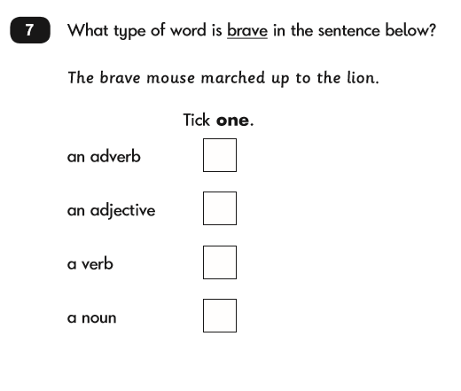
Key Stage One

Slide 6
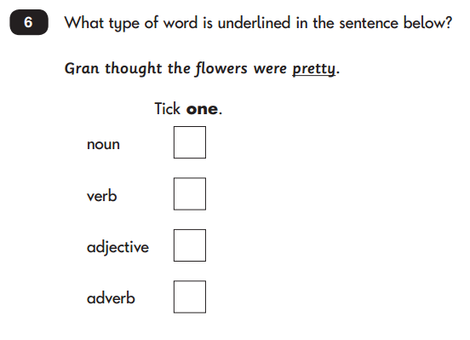
Key Stage One

Slide 7
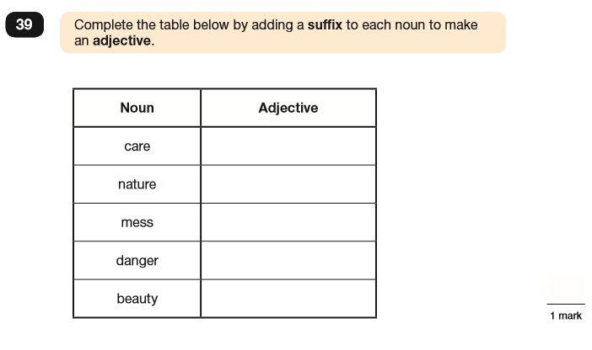
Key Stage Two
Notes:
Robyn

Slide 8
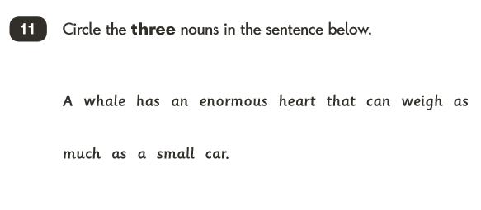
Noun
A noun is a person, place or thing.
Key Stage One
Notes:
Year 2 - Robyn

Slide 9
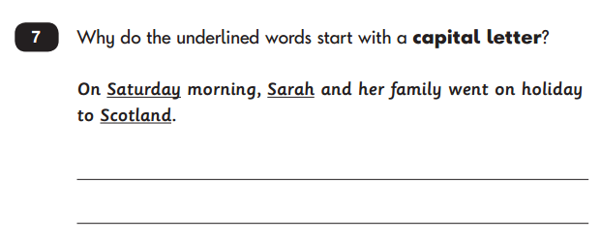
Key Stage One
Notes:
Nouns can be grouped into smaller categories e.g. proper, abstract, common etc. Children will not learn these, but they will learn that proper nouns require capital letters.

Slide 10
Key Stage Two

Slide 11
Pronoun
Possessive Pronoun
Pronoun
A pronoun replaces nouns to avoid repetition.
him
her
those
she
his
these
my
this
that
mine
Notes:
Year 4 - Robyn

Slide 12
Key Stage Two

Slide 13
Key Stage Two

Slide 14
Relative Pronoun
A relative pronoun is used to begin a description for a noun.
who, which, that, where, when
It’s used to introduce a relative clause.
Notes:
Year 5 - Robyn

Slide 15
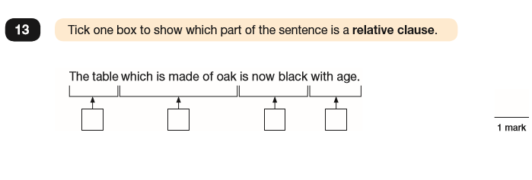
Key Stage Two

Slide 16
Punctuation for Parenthesis
Parenthesis is additional information inserted into a sentence as further explanation or an afterthought.
. , ? ! “” ‘ : ; () -
Notes:
Year 5 - Robyn

Slide 17
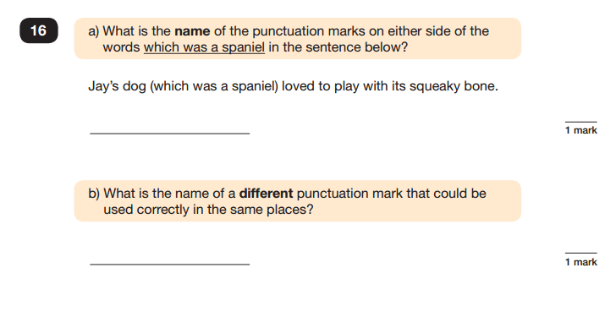
Key Stage Two

Slide 18
Noun Phrases
A noun phrase is a group of words, in which the noun is the most important.
Notes:
Year 2 - Becky

Slide 19
fox
the fox
the gentle fox
the gentle, caring fox
the gentle, caring fox with a heart of gold
Notes:
Year 2

Slide 20
Key Stage Two

Slide 21
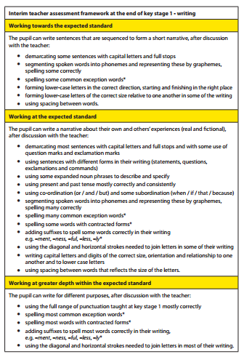
Key Stage One
using some expanded noun phrases to describe and specify
Notes:
Robyn

Slide 22
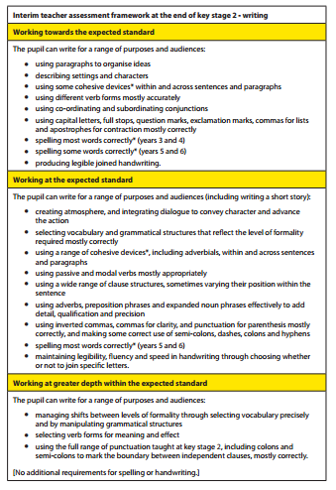
Key Stage Two
using some expanded noun phrases effectively to add detail, qualification and precision
Notes:
Robyn

Slide 23
Verb
A verb is a ‘doing word’. They can be classified by their tense: past, present or future.
Notes:
Year 2 - Becky

Slide 24
Key Stage One
Notes:
Only identifying the verbs are required.

Slide 25
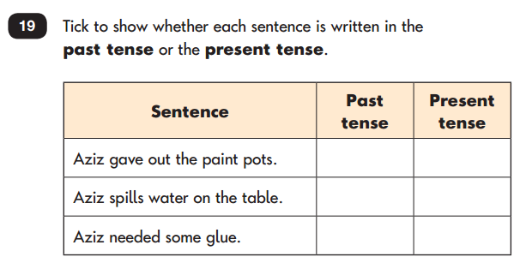
Key Stage One
Notes:
Children are required to identify the verbs and the their tense.

Slide 26
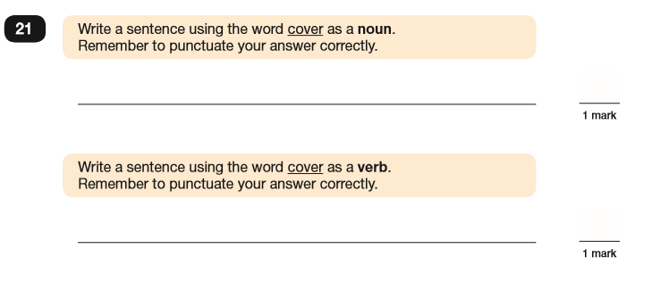
Key Stage Two
Notes:
Robyn

Slide 27
Adverb
An adverb describes a verb. It usually tells us how, when or where.
Notes:
Year 2 - Robyn

Slide 28
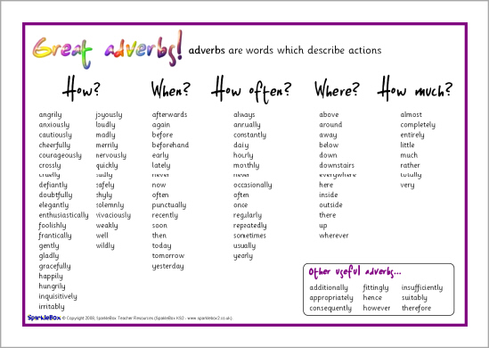

Slide 29
Key Stage One

Slide 30
Key Stage Two

Slide 31
Key Stage Two

Slide 32
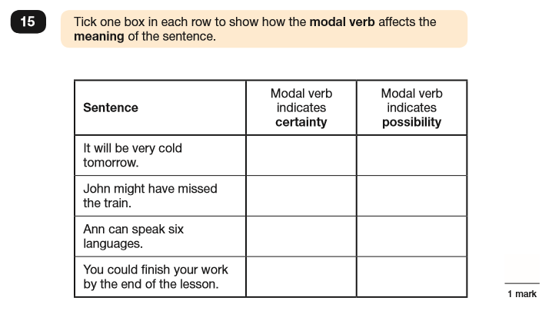
Modal Verb
A modal verb expresses certainty.
Key Stage Two
Notes:
Year 5 - Robyn

Slide 33
Prepositions/Preposition Phrases
A preposition often describes a
location or direction.
Notes:
Year 3 - Becky

Slide 34
Key Stage Two
using preposition phrases to add detail, qualification and precision

Slide 35
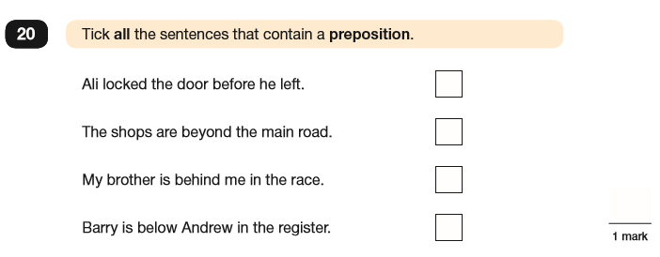
Key Stage Two

Slide 36
Conjunctions
(Connectives)
A conjunction links two words or phrases together.
co-ordinating
subordinating
Notes:
Year 3 - Becky

Slide 37
co-ordinating
subordinating
F
A
N
B
O
Y
S
or
nd
or
ut
r
et
o
A
W
I
T
E
B
U
S
lthough, as, after
Hile, when, which
f, in order that
hough, that
ven though, even if
ecause, before
ntil, unless
ince

Slide 38
Key Stage One
using co-ordination (or/and/but) and some subordination (when/if/that/because)

Slide 39
Key Stage Two
using co-ordinating and subordinating conjunctions

Slide 40
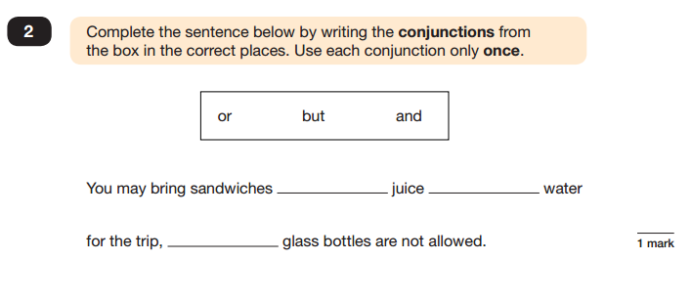
Key Stage Two

Slide 41
Key Stage Two

Slide 42
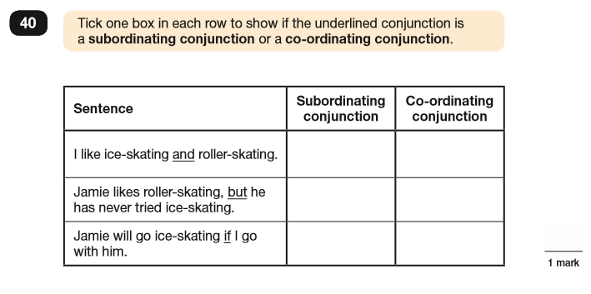
Key Stage Two

Slide 43
Subordinate Clause
A subordinate clause is a clause which is subordinate to another part of the sentence. It is introduced using a subordinating conjunction.
subordinate: lowly, minor, inferior, lesser
Notes:
Year 3 - Robyn

Slide 44
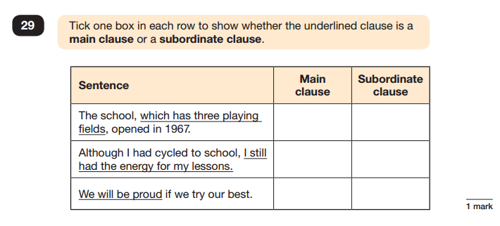
Key Stage Two

Slide 45
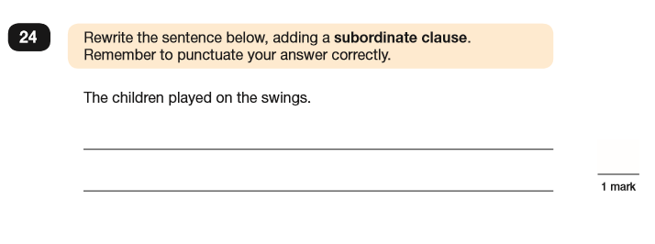
Key Stage Two
Relative clauses are always subordinate.

Slide 46
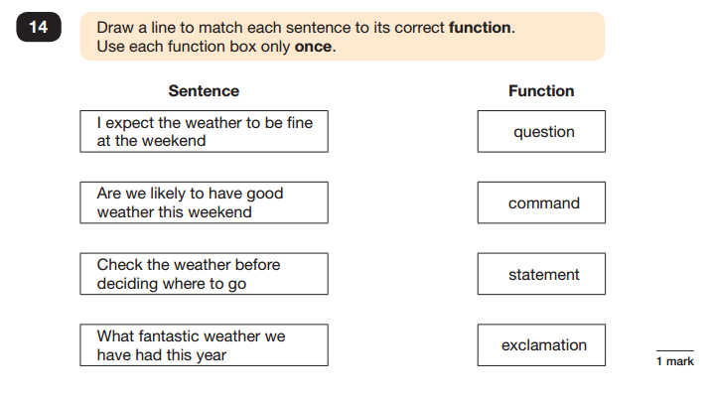
Statement
Question
Exclamation
Command
Key Stage Two
Notes:
Year 2 - Robyn

Slide 47
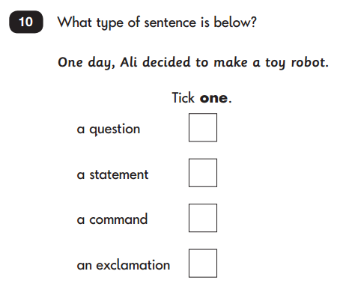
Key Stage One

Slide 48
Key Stage One
using sentence with different forms in their writing (statements, questions, exclamations and commands)

Slide 49
Colon (:) vs. Semi-Colon (;)
A colon (:) is used to provide a pause, before introducing related information.
It is often used to introduce a list.
To make the perfect jam sandwich, you will need three things: bread, jam and butter.
Notes:
Year 6 - Robyn

Slide 50
Colon (:) vs. Semi-Colon (;)
A colon (:) is used to provide a pause, before introducing related information.
It can also be used to introduce a definition or explanation of something.
I know how I’m going to handle this: I’m going to hide!
Notes:
Year 6

Slide 51
Colon (:) vs. Semi-Colon (;)
A semi-colon (;) is used to join together two clauses, which could be separate sentences, but are closely related to one another.
John calls it football; Sam calls it soccer.
It’s used to make the reader think about the relationship between the two clauses.
Notes:
Year 6

Slide 52
Key Stage Two
making some correct use of colons and semi-colons

Slide 53
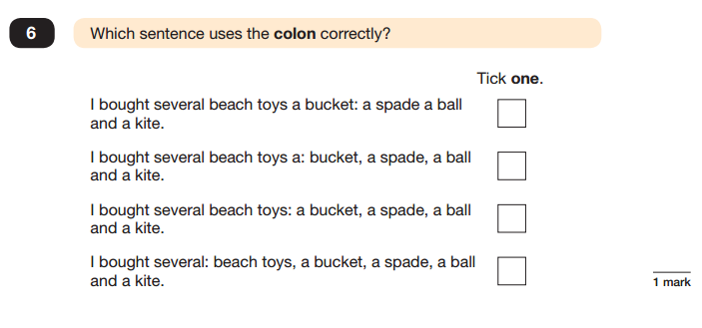
Key Stage Two

Slide 54
Key Stage Two

Slide 55
Key Stage Two

Slide 56
Key Stage One
Apostrophes (‘) for Contraction
Notes:
Year 2 - Robyn

Slide 57
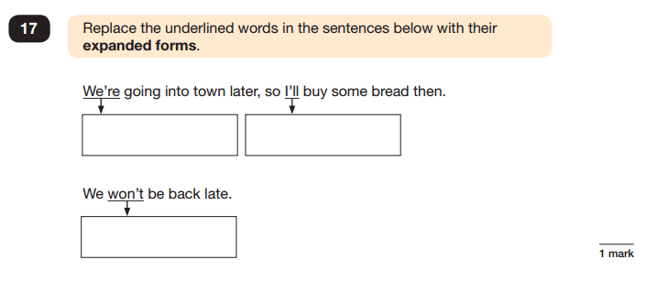
Key Stage Two

Slide 58
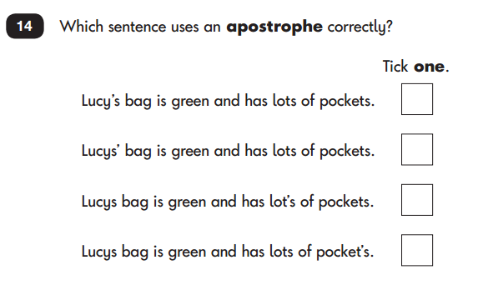
Key Stage Two
Apostrophes (‘) for Possession
Notes:
Singular – Year 2; Plural – Year 4

Slide 60
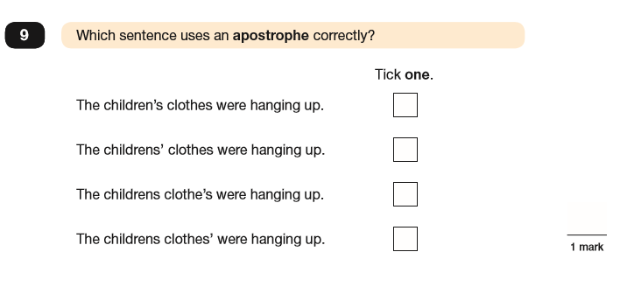

Slide 61
Handouts
Presentation Slides
Spelling Lists
NC Glossary
NC SPAG Appendices?

